Slide 1
CSE 486/586 Distributed Systems Case Study: TOR Anonymity Network
Bahadir Ismail Aydin
Computer Sciences and Engineering
University at Buffalo

Slide 2
Outline
Overview
Users
Onion Routing
The Solution
Hidden services
The future of Tor
How to install/use TOR?

Slide 3
Overview
Onion routing project of the U.S. Naval Research Laboratory
Tor hides you among the other users on the network
Use: Using Tor protects you against a common form of Internet surveillance known as "traffic analysis."
What is traffic analysis? How does it work?

Slide 4
Users
Militaries use Tor
First designd with US Navy in mind
Normal people use Tor
Journalists and their audience use Tor
Law enforcement officers use Tor
Activists & Whistleblowers use Tor
High & low profile people use Tor
Business executives use Tor
Bloggers use Tor
IT Professionals use Tor

Slide 5
Onion Routing
Hide message source by routing it randomly
Popular technique: Crowds, Onion Routing, TOR
Routers don’t know for sure if the apparent source of a message is the true sender or another router
Only secure against local attackers!

Slide 6
Onion Routing
R
R
R₄
R
R₃
R
R₁
R
R₂
Alice
R
Bob
Sender chooses a random sequence of routers
Some routers are honest, some hostile
Sender controls the length of the path
Goal: hostile routers shouldn’t learn that Alice is talking to Bob

Slide 7
Onion Routing
R₂
R₄
Alice
R₃
Bob
R₁
{M}_{pk(B)}
{B,k₄}_{pk(R4)},{ }_{k4}
{R₄,k₃}_{pk(R3)},{ }_{k3}
{R₃,k₂}_{pk(R2)},{ }_{k2}
{R₂,k₁}_{pk(R1)},{ }_{k1}
Routing info for each link encrypted with router’s public key
Each router learns only the identity of the next router

Slide 8
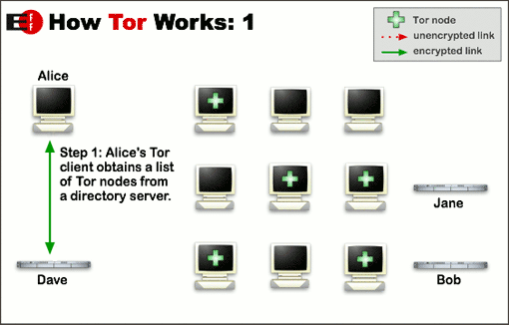
Solution

Slide 9
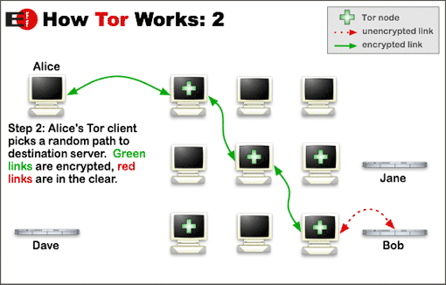
Solution

Slide 10
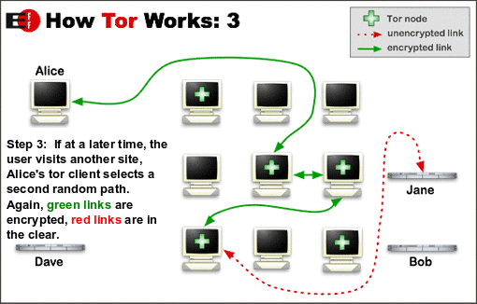
Solution

Slide 11
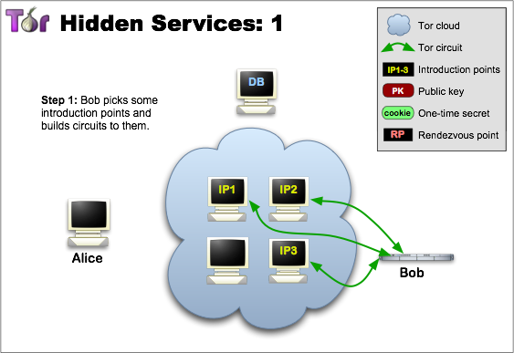
Hidden Services

Slide 12
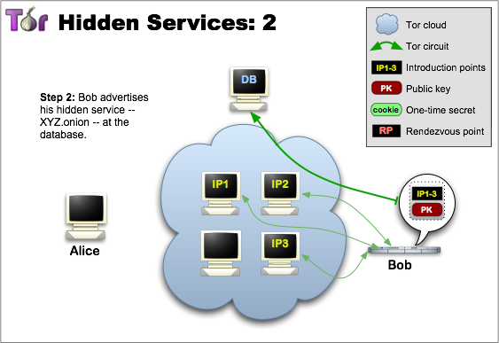
Hidden Services

Slide 13
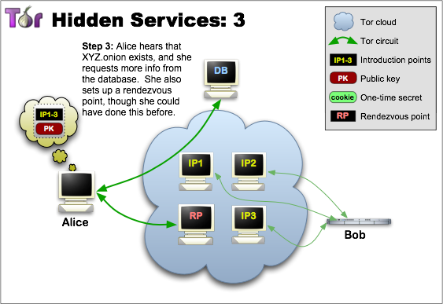
Hidden Services

Slide 14
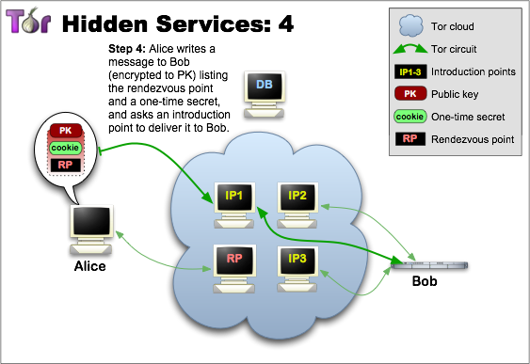
Hidden Services

Slide 15
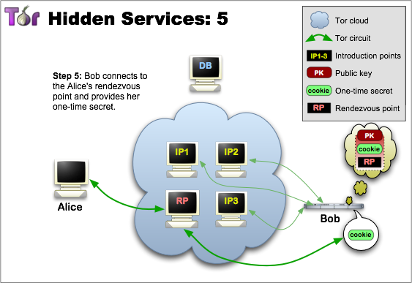
Hidden Services

Slide 16
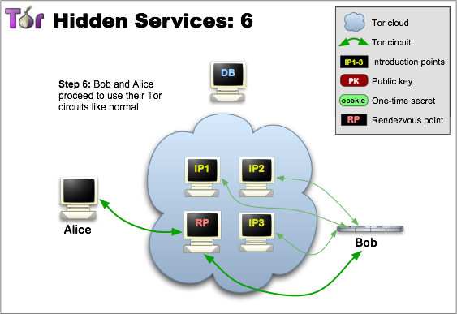
Hidden Services

Slide 17
Future for TOR
Tor can't solve all anonymity problems.
As Tor's usability increases, it will attract more users, which will increase the possible sources and destinations of each communication, thus increasing security for everyone. We're making progress, but we need your help. Please consider running a relay or volunteering as a developer.

Slide 18
How to install/use TOR?
http://www.youtube.com/watch?feature=player_detailpage&v=6xB_50VKxME#t=320s
https://media.torproject.org/video/2009-install-and-use-tor.ogv

